Slide 1
Basic training for County child welfare boards
As Offered by the Education committee of the
Texas council of child welfare boards, Inc.

Slide 2
CONGRATULATIONS!
We salute your decision to be a force in assisting to improve the lives of many children you may never meet, who have survived situations you would not care to imagine. Our collective experiences in networking with others who are similarly dedicated is solely aimed at helping each of you better understand your role and the similarly important roles of all parties involved. We cannot possibly provide you all the answers, but we hope to give you a simple overview to help with your duties. Working together with the network of local, regional, and State volunteer organizations to improve lives is a the aim of the Texas Council of Child Welfare Boards.

Slide 3
Texas Family Code , Section 264.005
Your county’s Child Welfare Board (CWB) was created pursuant to this statute and a few others, which advise the Commissioners Court about appointment of volunteer members, as well as its size and role as local liaison and advisor. Most Commissioners Courts also have a contract with DFPS which calls for creating a local welfare board.
In your role as a governing official, you are responsible to:
your Commissioners Court;
your child welfare organization;
the Department of Family and Protective Services (DFPS), and
your community, especially including its children and youth.

Slide 4
Organizing a child welfare board
The extent to which your board organizes is up to its membership and the Commissioners Court responsible for continued appointments. Our experience is that possessing a clear sense of purpose with a strong organizational framework is helpful. Recommended items are listed in the TCCWB Training Manual, including Leadership Job Descriptions.
Membership rosters are essential for notices; however, for privacy, newly appointed members should be aware that Texas law provides that they may elect to keep confidential some required contact information like their home address and phone, Social Security number, or information that reveals the identity of family members.

Slide 5
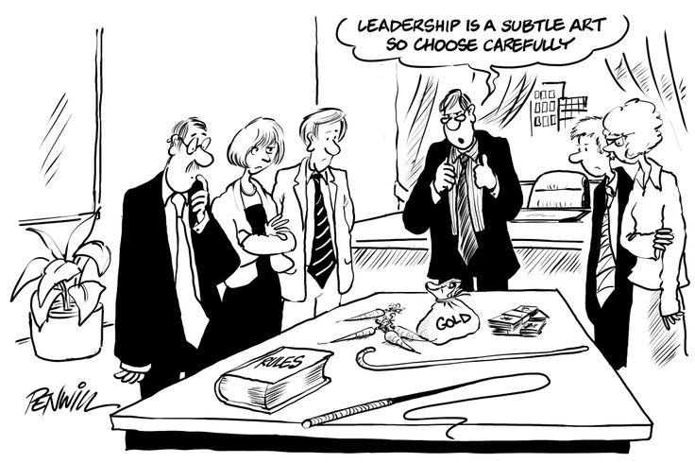

Slide 6
Open Government Training - required!
Within 90 days of appointment, you must complete a course provided through the Office of the Attorney General. The online course concludes with instructions on evidencing your study with certificates to be filed in the office of your County Clerk.
While this law governs your official interactions with other CWB members in and out of open meetings, compliance should not be that difficult. But remember, violation of this act (or certain confidentiality rules) may be prosecuted as a serious misdemeanor.

Slide 7
Dfps/Cps clearance
EARLY ON, COMPLETE THE PAPERWORK: You may download from the TDFPS website (or they can provide you with) Form C-105-0250, their Volunteer Application and annual background check authorization, as well as others, like Form 251 for acknowledging your pledge of confidentiality regarding potential sharing of privileged client/family information, transportation of consumers (Form 250c), etc., etc., etc.

Slide 8
be A LOCAL SAFETY NET
When emergency removals occur, your CWB can be of great help to the caseworker in need of basic supplies to help transition a child into a safer setting. The fact is that, in a crisis, children leave homes with nothing but the clothes on their backs. CWB’s have been assisting with clothing and supplies for decades. “Rainbow Rooms” are an outgrowth of that reality: children with immediate needs.
Later on, there will be specific items the State cannot readily have anticipated, for which you may be asked to assist in providing. There is no requirement; there are no special rules; a CWB should simply do what it can to help.

Slide 9
Support cps case work
It’s a stressful, hazardous job… so, please consider this before starting to criticize. Their personnel are confronted on all sides!
Then take a deep breath… and think how you could improve the lot of and appreciate the front line CPS worker.
You will be helping responders who deal with Texas children and families daily. Working TOGETHER we can shift the focus toward helping children.

Slide 10
Fun(d)raising
FACE IT: There is rarely enough funding for our target beneficiaries!
Yet, with relatively little effort, we do supplement caregivers’ efforts to provide a better future for Texas children. Get creative and the rewards will follow… even if postponed “stars in your crown.”
Take advantage of your non-profit status: buy sales tax-exempt; seek grants, interest, and other income which are not taxable to a CWB; and there are many avenues to non-profit status: governmental exemption, Comptroller acknowledgment, or formal IRS recognition. So, be sure to provide donors with receipts acknowledging their charitable contribution. And, don’t ignore the use of social media. Excellent ideas abound!
Check out the TCCWB Training Manual for more.

Slide 11
ADVOCATE FOR CHILDREN
As a grass roots political appointee you already are accepted as a local expert. Keep your area and state representatives informed about child welfare issues which need to be addressed. Then, by volunteering at the regional and state level you can further assist in raising awareness and funding for abused and neglected children. Contact your DFPS Community Initiative Specialist (CIS) to see how to become more supportive of regional CWB councils and the TCCWB.

Slide 12
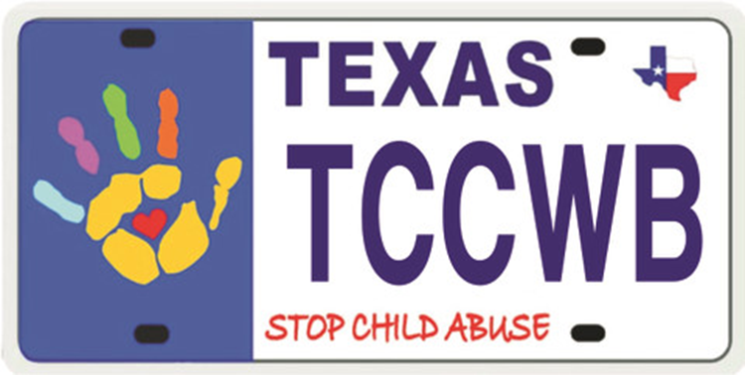
We Can Partner with a Growing Community

Slide 13
"There is no such thing as a stupid question if it's sincere. Better to ask and risk appearing stupid than to continue on your ignorant way and make a stupid mistake.”
Van Buren, Abigail (December 3, 1970) “Time Waits for No One,” The Milwaukee Sentinel

Slide 14
CONTACT INFORMATION: TEXAS COUNCIL OF CHILD WELFARE BOARDS, INC. P.O. Box 42363 Austin, Texas 78704-2363 (512) 484-8598 www.tccwb.org George Ford, LMSW-AP, J.D., Executive Director gford@tccwb.org

